Slide 1


COVID19’S IMPACT
in SPAIN’S HOSPITALS
by Dàmaris Clariana & Marta Martí
DATA ANALYST BOOTCAMP JUNE 2021, BARCELONA

Slide 2
PROJECT APPROACH

Slide 3
PROJECT APPROACH
RESEARCH,
ANALYSIS AND
DATA CLEANING
OBJECT 1 - How was Covid-19 impact in Spain’s hospitals from March to May 2020?
Understand and analyze the data.

Slide 4
PROJECT APPROACH
DATA PROCESSING
AND EXTRACTING
CONCLUSIONS
OBJECT 1
Understand and analyze the data.
OBJECT 2 - Let’s explain it on a visual way!
Answer questions of interest about Covid first evolution in Spain through visualizations based on the data.

Slide 5
PROJECT APPROACH
PYTHON
TABLEAU
OBJECT 1
Understand and analyze the data.
OBJECT 2
Answer questions of interest about Covid first evolution in Spain through visualizations based on the data.

Slide 6
CONCLUSIONS

Slide 7
HOW WAS COVID-19 EVOLUTION
IN THE FIRST 2 MONTHS?

Slide 8
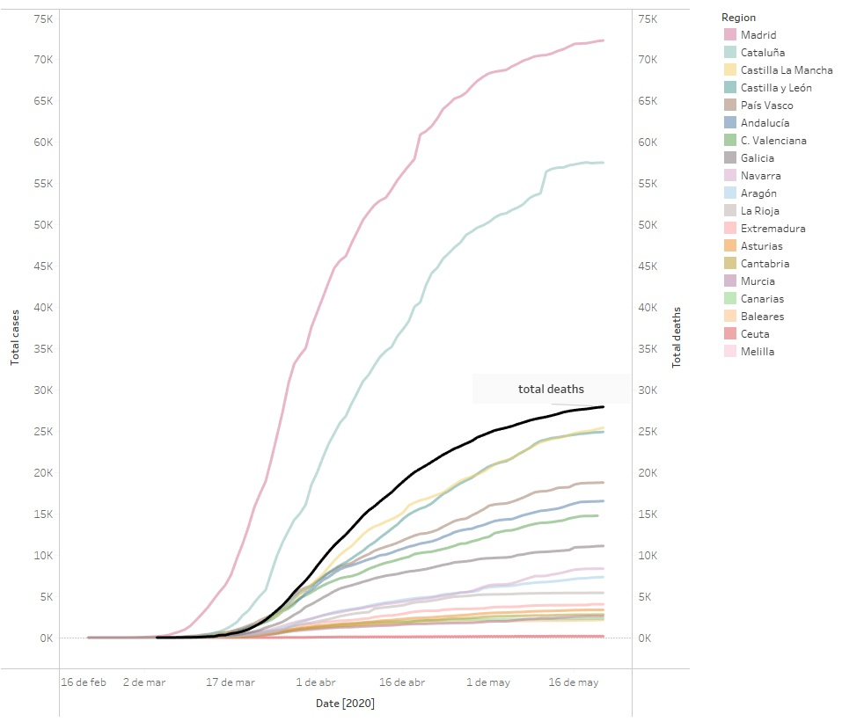
Cases by region and deaths evolution
HOW WAS THE COVID-19 EVOLUTION IN THE FIRST 2 MONTHS?

Slide 9
Cases by region and deaths evolution
HOW WAS THE COVID-19 EVOLUTION IN THE FIRST 2 MONTHS?
Catalonia and Madrid were the most affected regions by far. With big metropolis connected to foreign countries.
It’s stunning to see the quick deaths evolution.

Slide 10
WHICH REGIONS
WERE MORE AFFECTED?

Slide 11
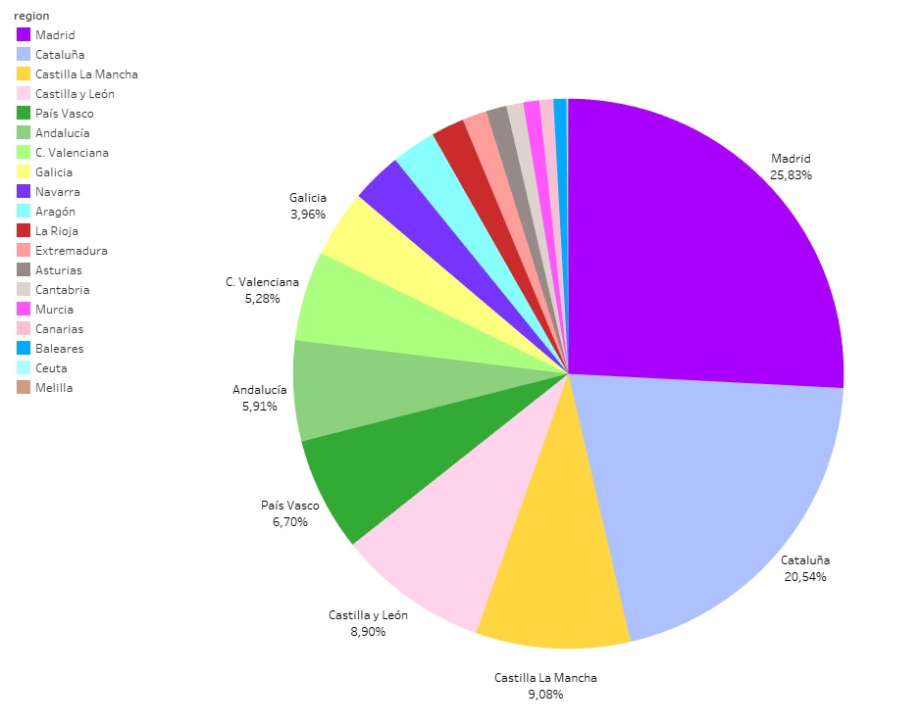
Cases by region
WHICH REGIONS
WERE MORE AFFECTED?

Slide 12
Cases by region
WHICH REGIONS
WERE MORE AFFECTED?
Madrid and Catalonia were the most infected regions with almost the 50% of the general infection in the country.
Followed by Castilla La Mancha, Castilla y León and País Vasco.

Slide 13
HOW THE COVID-19 AFFECTED
BY GENDER AND AGE?

Slide 14
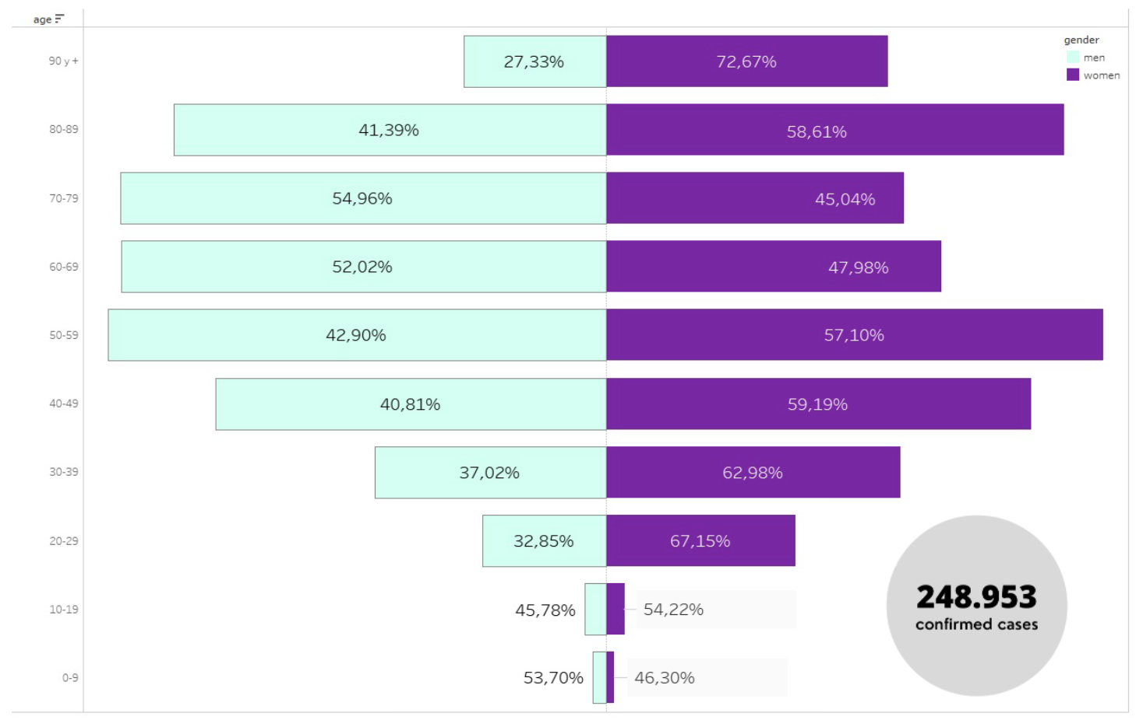
HOW THE COVID-19 AFFECTED BY GENDER AND AGE?
Cases by age and gender

Slide 15
HOW THE COVID-19 AFFECTED BY GENDER AND AGE?
GENDER: more women than men got infected but there’s not a very big difference. (except some specific groups of age)
AGE: Covid-19 hit specially from 50 years old and upwards.
Lower impact in youngest ages.
Cases by age and gender

Slide 16
WHICH AGE GROUP
SUFFERED MORE DEATHS?

Slide 17
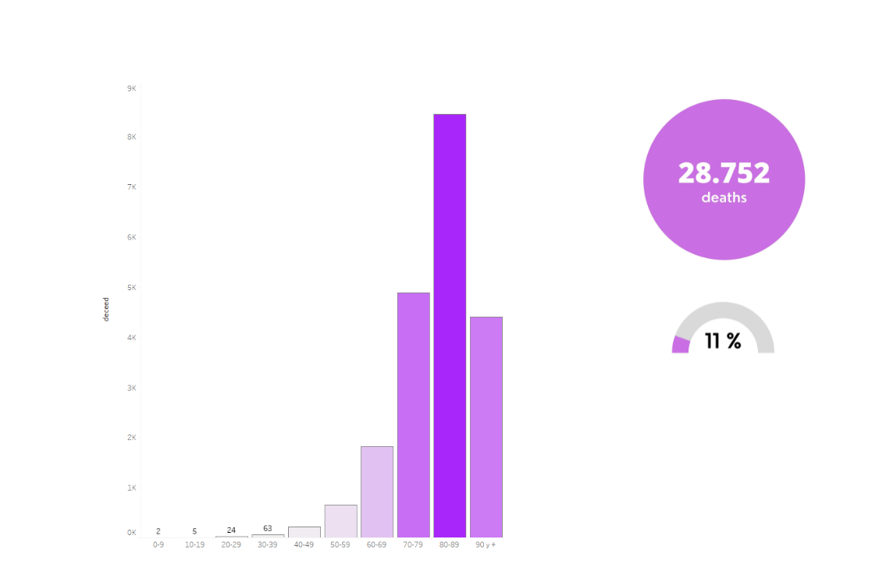
Deaths by age
WHICH AGE GROUP
SUFFERED MORE DEATHS?

Slide 18
Deaths by age
WHICH AGE GROUP
SUFFERED MORE DEATHS?
11% of infected people died during those 2 months.
The level of mortality was significantly higher in those who were older than 70.

Slide 19
WHICH PROPORTIONS OF DEATHS VERSUS HOSPITAL DISCHARGES
DID EVERY REGION HAD?

Slide 20
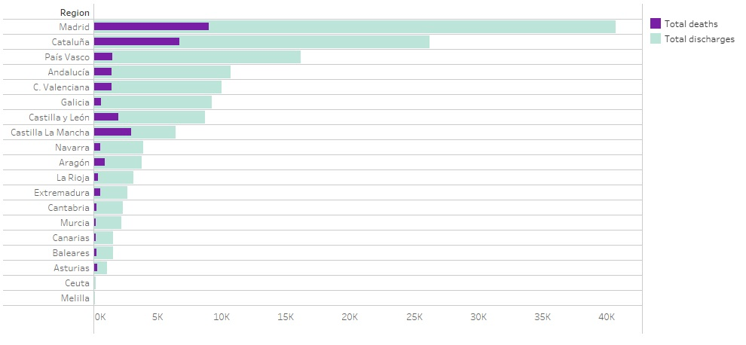
RELATION OF DEATHS
VERSUS DISCHARGES
Deaths versus Hospital discharges

Slide 21
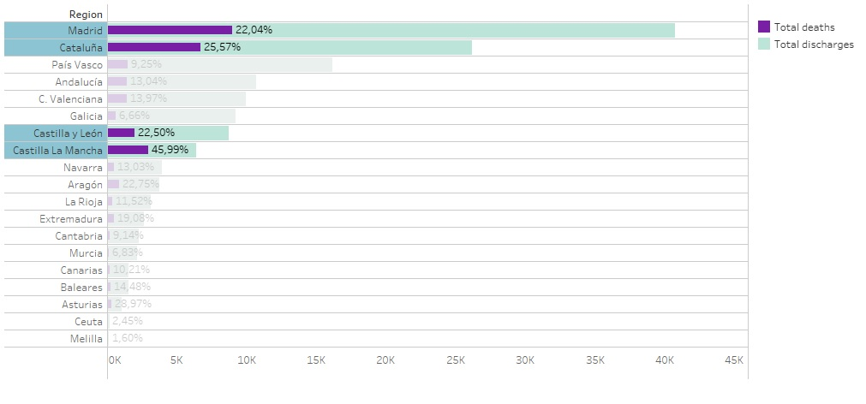
A MATTER OF QUALITY?
Comparison of successful hospital discharges versus death cases by region.
Places with higher cases but also rural areas with less resources suffered higher death index.
Deaths versus Hospital discharges

Slide 22
WERE THERE ENOUGH ICU BEDS?

Slide 23
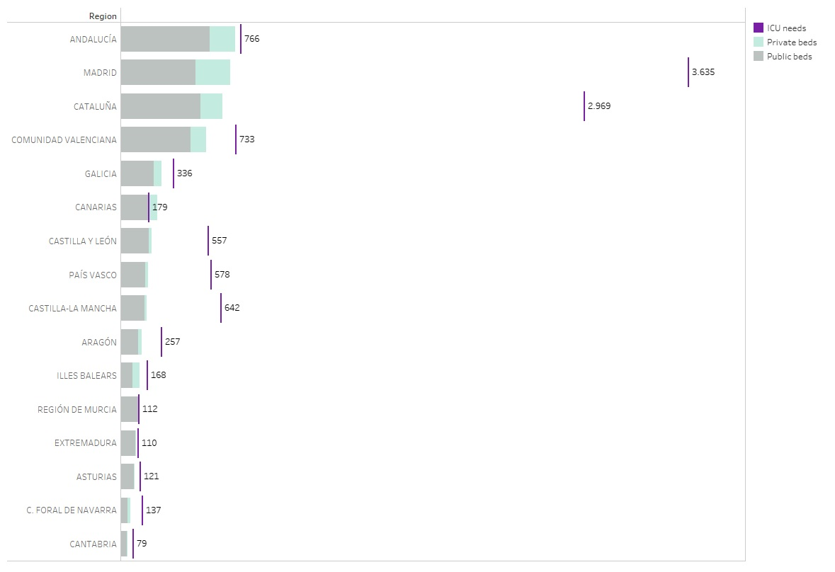
ICU beds
WERE THERE ENOUGH ICU BEDS?

Slide 24
ICU beds
WERE THERE ENOUGH ICU BEDS?
Not all the areas had as many UCI beds as needed.
This difference becomes relevant if we compare it with the areas with a higher proportion of deaths, where the two Castillas as well as Madrid and Catalonia suffered from both situations.
The Vasque Country, despite the lack of beds, maintained the number of deaths much more successfully under control.

Slide 25
FINAL REMARKS
DATA ANALYST BOOTCAMP JUNE 2021, BARCELONA

Slide 26
FINAL REMARKS
These conclusions are not representative for the entire Covid’s evolution in Spain. The data we collected only belongs to the beginning of the pandemic: March, April and May 2020.
DATA ANALYST BOOTCAMP JUNE 2021, BARCELONA

Slide 27
FINAL REMARKS
These conclusions are not representative for the entire Covid’s evolution in Spain. The data we collected only belongs to the beginning of the pandemic: March, April and May 2020.
Data available in this period might not be accurate since PCR’s back then were not always available.
DATA ANALYST BOOTCAMP JUNE 2021, BARCELONA

Slide 28
THANKS!
by Dàmaris Clariana & Marta Martí
DATA ANALYST BOOTCAMP JUNE 2021, BARCELONA

